Slide 1
welcome
To Implementing physical security policy on webcam in devices to prevent spyware activities

Slide 2
Project
Project was developed by
P. Andy Gomes,
D. Hari Babu,
N. Sai Keerthana,
G. Ananth Mohan Kuma

Slide 3
contents
Abstraction……………………………………………………………………..
physical security policy……………………………………………..
What is a webcam? ………………………………………………………….
physical security policy on webcam……………………………
What is spyware? …………………………………………………………….
Types of attackes performs on webcams ………………….
Spyware attackes performs on webcams …….…………….
Prevent the webcams on spyware activities ………………
Web cam attacks in cyber security …………………………………..
Project ……………………………………………………………….
Result ……………………………………………………………………………...

Slide 4
Abstraction
Webcam Protection: Use physical measures like webcam covers or privacy screens to block the camera lens when not in use.
Device Placement: Ensure webcams are positioned in a way that sensitive areas or information are not inadvertently captured.
Physical Audits: Regularly check compliance with the policy, including webcam cover usage and device positioning, and look for signs of tampering.
User Training: Educate users about webcam risks, proper webcam cover usage, and caution regarding camera permissions.
Secure Device Storage: Encourage users to store devices securely when not in use, using locked drawers, cabinets, or carrying cases.

Slide 5
physical security policy
Access Control : Define access control measures to limit physical access to facilities, areas, and sensitive assets. This may include the use of keycards, biometric systems, or security guards to ensure only authorized individuals can enter designated areas.
Perimeter Security : Establish procedures for securing the perimeter of facilities, such as fences, gates, or barriers, to prevent unauthorized access to the premises.
Surveillance and Monitoring : Implement video surveillance systems and monitoring mechanisms to record and monitor activities within and around the premises. Define retention policies for video footage and procedures for reviewing and investigating any security incidents.
Visitor Management : Develop procedures for managing visitors, including visitor registration, issuance of visitor badges, and escorting protocols for authorized areas.
Security Awareness and Training : Provide security awareness programs and training to educate employees on physical security best practices, including recognizing and reporting suspicious activities or individuals.
Asset Protection : Implement measures to protect physical assets, such as computers, servers, and equipment, from theft or unauthorized access. This may involve locking mechanisms, secure storage, and inventory management procedures.

Slide 6
Incident Response: Define procedures for responding to security incidents, including reporting mechanisms, escalation protocols, and coordination with law enforcement if necessary.
Physical Security Reviews and Audits: Conduct regular reviews and audits of physical security measures to ensure compliance with the policy, identify vulnerabilities, and implement necessary improvements.
Emergency Response and Disaster Recovery: Establish protocols for emergency situations, including evacuation procedures, emergency contacts, and business continuity plans to minimize the impact of security incidents or natural disasters.
Contractor and Vendor Management: Define requirements and procedures for managing access and security measures for external contractors, vendors, or service providers working on-site.

Slide 7
What is a webcam
webcam
A webcam is a small digital video camera that connects to a computer. It is also known as a web camera that can capture pictures or motion video. These cameras come with software that needs to be installed on the computer that helps transmit its video on the Internet in real-time. It has the ability to take pictures, including HD videos, but its video quality can be lower as compared to other camera models.
Webcams are great. They allow us to easily communicate face-to-face with family and friends even if they are on the other side of the world. They allow journalists to interview people in far flung corners of the world. They allow entrepreneurs in remote locations do business with people in big cities across the globe.

Slide 8
physical security policy on webcam
Webcam Covers: Mandate the use of webcam covers or privacy screens to physically block the webcam lens when not in use. Ensure that these covers are easily accessible, durable, and suitable for the specific device.
Device Placement: Educate users about appropriate device placement to minimize privacy risks. Encourage positioning devices in a way that the webcam is not unintentionally pointing towards sensitive areas or confidential information.
Physical Inspections: Conduct regular physical inspections of devices to ensure compliance with the policy. Check if users have installed webcam covers correctly and inspect for any signs of tampering or unauthorized modifications to the webcam.
User Awareness and Training: Provide comprehensive training and awareness programs on webcam security. Educate users about the risks associated with webcam spying, the importance of using webcam covers, and caution when granting camera permissions to applications or websites.
Secure Storage: Emphasize the importance of secure device storage when webcams are not in use. Encourage users to store devices in locked drawers, cabinets, or carry cases to prevent unauthorized access.

Slide 9
What is spyware
Spyware is malicious software designed to secretly gather information from a user's device without their knowledge or consent. It is typically installed on a device without the user's awareness and operates covertly in the background, monitoring and collecting sensitive data.
The main objective of spyware is to gather valuable information, such as personal details, browsing habits, login credentials, financial information, or other sensitive data, and transmit it to the attacker or a third party. This information can be used for various malicious purposes, including identity theft, fraud, espionage, or unauthorized surveillance.
Spyware can be spread through various means, including malicious downloads, infected email attachments, deceptive websites, or bundled with legitimate software. Once installed, it may run silently in the background, capturing keystrokes, recording audio or video, monitoring browsing activities, and tracking sensitive information.
Common types of spyware include keyloggers, which record keystrokes to capture passwords and other confidential information, and screen recorders, which capture screenshots or record the user's screen activity. Other spyware variants include webcam hijackers, which gain unauthorized access to a device's webcam, and information stealers, which target sensitive data like credit card numbers or social security numbers.
Spyware is a significant threat to privacy and security, as it violates an individual's confidentiality and can lead to financial loss or identity theft. Protecting against spyware involves using reputable antivirus and anti-malware software, regularly updating software and operating systems, practicing safe browsing habits, being cautious with downloads and email attachments, and maintaining strong security practices.

Slide 10
Types of attackes
Remote Access Trojan (RAT)
Webcam Hijacking
Malware and Spyware
Social Engineering
Webcam Spoofing

Slide 11
Spy ware attackes performs on webcams
Malicious Software Downloads: Attackers may trick users into downloading and installing malicious software, such as trojans or spyware, onto their devices. This can happen through deceptive email attachments, infected websites, or compromised software downloads. Once installed, the spyware gains control over the webcam, allowing the attacker to monitor or record video and audio.
Exploiting Software Vulnerabilities: Attackers can exploit vulnerabilities in webcam drivers, operating systems, or software applications to gain unauthorized access to webcams. By leveraging these vulnerabilities, they can remotely activate the webcam without the user's knowledge or consent.
Remote Access Trojans (RATs): Remote Access Trojans are malicious programs that enable attackers to gain full control over a compromised device, including the webcam. RATs can be deployed through various means, such as phishing emails, infected downloads, or social engineering techniques. Once installed, the attacker can remotely access and manipulate the webcam.
Social Engineering: Attackers may use social engineering tactics to deceive users into granting webcam access. This can involve impersonating trusted entities, such as technical support personnel, and convincing users to enable remote access or download malicious software that grants unauthorized webcam control.
Webcam API Abuse: Applications that use the webcam API (Application Programming Interface) may have vulnerabilities that attackers can exploit to gain unauthorized access. By manipulating or bypassing the API, they can take control of the webcam and capture video or audio.
Physical Compromise: In some cases, attackers with physical access to a device can compromise the webcam. They may physically tamper with the camera hardware, bypass any physical security measures, or replace the webcam with a maliciously modified one that allows them to remotely monitor or record video.

Slide 12
Prevent the webcams on spyware activities
Use Reliable Security Software: Install reputable antivirus and anti-malware software on your device and keep it up to date. This software can help detect and block spyware from infecting your system, including any attempts to compromise your webcam.
Be Cautious with Downloads and Links: Exercise caution when downloading files or clicking on links, especially from untrusted sources or unfamiliar websites. Spyware can be disguised as legitimate files or links, so be vigilant and verify the authenticity of the source before proceeding.
Manage Webcam Permissions: Review and manage the list of applications and websites that have access to your webcam. Only grant camera permissions to trusted and essential applications. Regularly audit and revoke permissions for unused or suspicious applications.
Use Webcam Covers or Privacy Screens: Employ physical measures like webcam covers or privacy screens to physically block the camera lens when the webcam is not in use. This ensures that even if spyware gains unauthorized access, the camera remains physically obstructed.
Be Wary of Webcam Indicator Lights: Pay attention to the webcam indicator light on your device. If the light turns on unexpectedly, without any apparent reason or user action, it could indicate unauthorized webcam access. Investigate the situation further and take appropriate action.
Secure Your Device: Implement strong security practices for your device, including using strong and unique passwords, enabling two-factor authentication, and securing your device with a firewall. This helps prevent unauthorized access to your system, including your webcam.

Slide 13
Web cam attacks in cyber security
When it comes to online spying, some people would rather be safe than sorry. Kaspersky surveyed 11,135 people aged 16 and older in 23 countries to find out who’s covering up their webcam. Are baby boomers more likely to take this precaution than members of the wired generation? Where is this practice most widespread? The results shown in our infographic may surprise you.

Slide 14
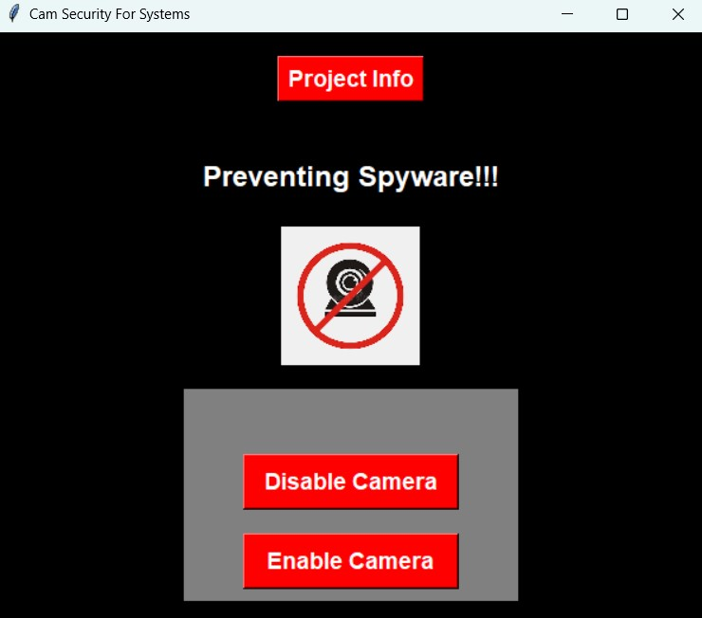
Project info

Slide 15
Used tools
Bat file
Sublime text 3
Python 3.9.7

Slide 16
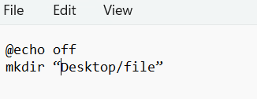
Batfile
A BAT file, short for "batch file," is a type of script file commonly used in Windows
operating systems. It contains a series of commands that are executed by the
command interpreter, typically Command Prompt or PowerShell. Here's some
information about BAT files and their usage:
➢ Scripting and Automation: BAT files are used for scripting and automating repetitive
tasks on Windows systems. By writing a series of commands in a BAT file, you can
automate tasks such as file operations, system configurations, running programs.
➢ Command Execution: When a BAT file is executed, the commands within it are
executed sequentially by the command interpreter. This allows you to perform
multiple operations in a batch without the need for manual intervention etc….
Save this with .bat extention

Slide 17
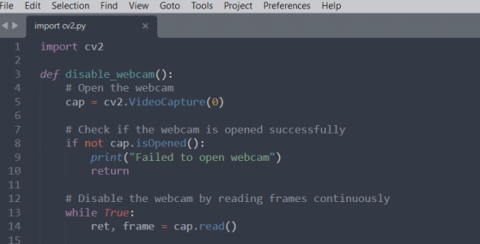
Sublime text 3
Sublime Text 3 (ST3) is a lightweight, cross-platform code editor known for its speed, ease of use, and strong community support. It’s an incredible editor right out of the box, but the real power comes from the ability to enhance its functionality using Package Control and creating custom settings

Slide 18
Python 3.9.7
Readability and Simplicity: Python is known for its clean and readable syntax. Its code is easy to understand and maintain, making it a beginner-friendly language. The simplicity of Python allows developers to express concepts and solve problems more efficiently.
➢ Versatility: Python is a versatile language that can be used for a wide range of
applications. It is commonly used for web development, data analysis, scientific
computing, artificial intelligence, machine learning, automation, and scripting. Its
extensive libraries and frameworks make it suitable for various tasks.
➢ Large and Active Community: Python has a vast and active community of developers,
which means there is an abundance of resources, tutorials, and documentation
available. The community actively contributes to the development of libraries,
frameworks, and tools, making it easier to find solutions to problems and receive support.
➢ Rich Ecosystem: Python provides a rich ecosystem of libraries and frameworks that
offer pre-built functionalities, allowing developers to save time and effort. For
example, NumPy and Pandas are widely used for data manipulation and analysis,
while Django and Flask are popular web development frameworks.

Slide 19
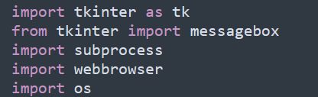
Packges
We used some packges to develop this code .
The packes are

Slide 20
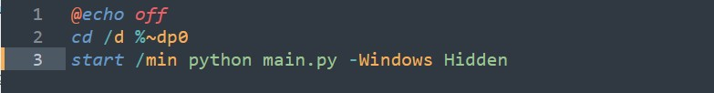
Code Back end process
To open this interfce we have to run a bat in the bat file backend process code will be performed (code shown below)
Here when clicked on disable button the back end process is
when clicked on enable button the back end process is

Slide 21
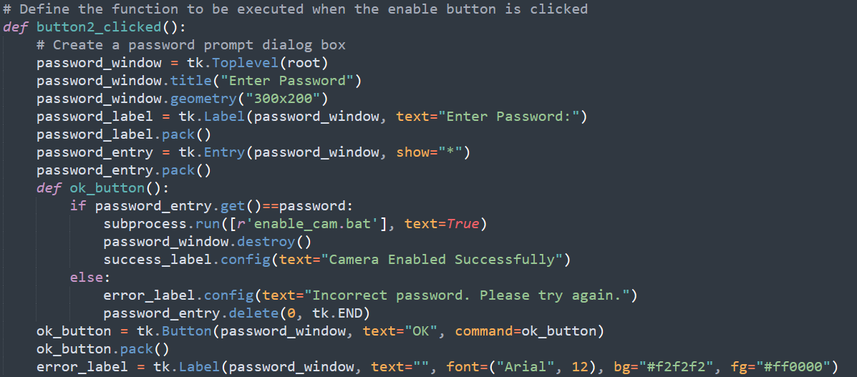
Enable cemara
enable camera back end code in python

Slide 22
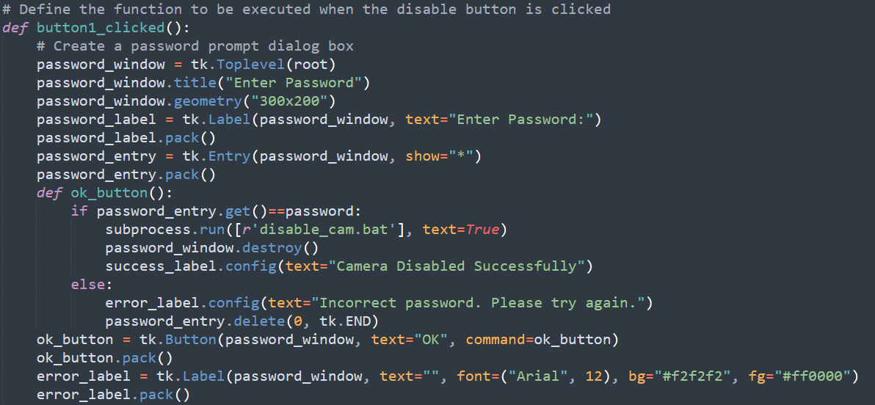
Disable camera
enable camera back end code in python

Slide 23
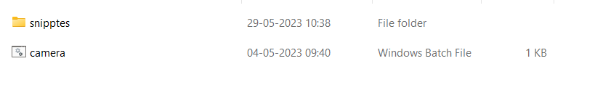
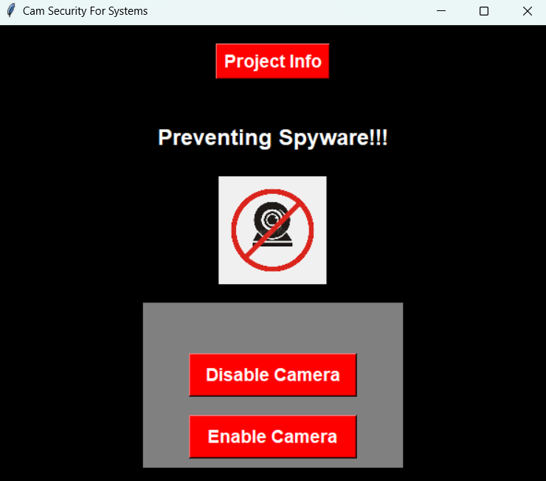
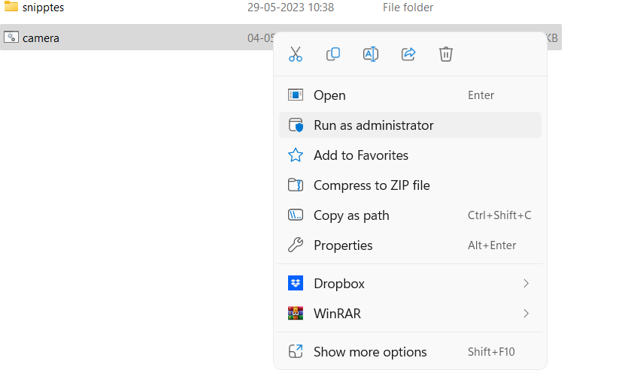
project
Opening this application named as cemara and need to open file run as adiminstrater
Then it will display

Slide 24
Here we used three buttons named as
Project info
Enable camera
Disable camera

Slide 25
project info
we have to create the html code and link to project info

Slide 26
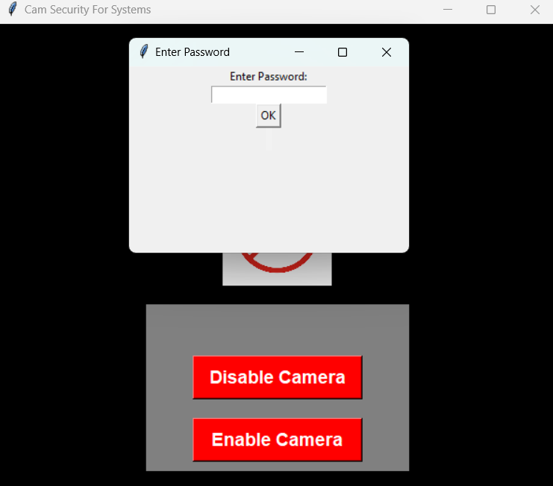
disable camera
Click on disable camera it will display a popup on top
Here yoo need enter the password and click on ok . if you enter the correct password it will
disable the cemara

Slide 27
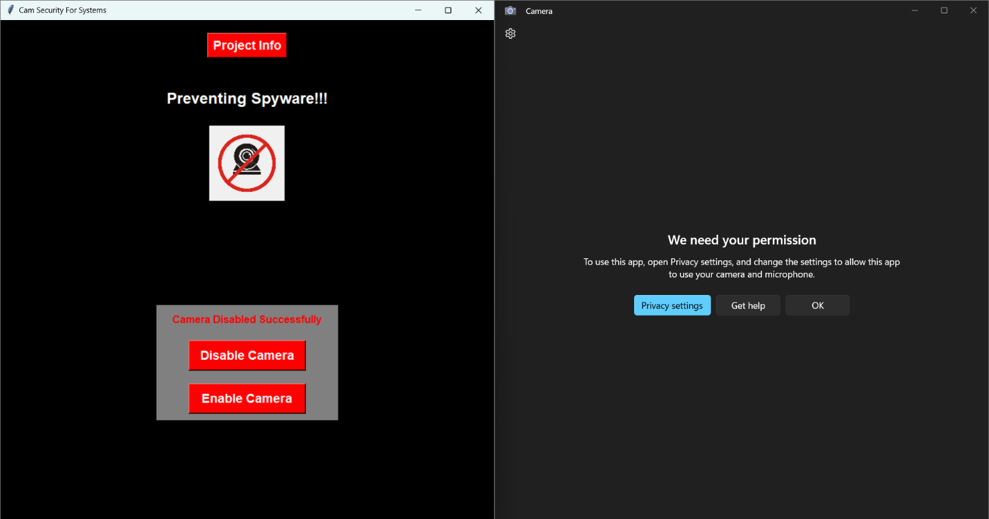
And it will shown as cemara disable successfilly.
after disabling camera if you need to check the cameara whether disabled or not
then web cam it will display shown below

Slide 28
Enable camera
Click on enable camera it will display a popup on top
Here you need enter the password and click on ok . if you enter the correct password it will
enable the camera

Slide 29
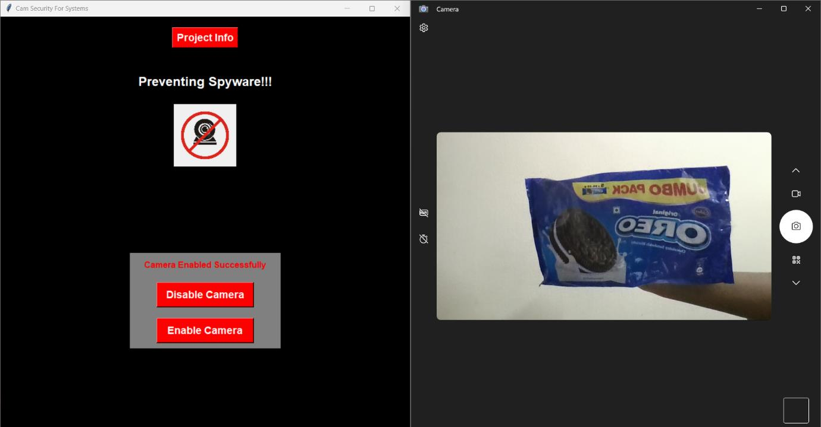
And it will shown as camera enable successfilly.
after enabling camera if you need to check the cameara whether enabled or not

